Slide 1



Creating Predicting Air Quality Index Using Python
In this presentation, we will explore the importance of monitoring air quality and introduce the concept of the Air Quality Index (AQI). Join us on this journey to learn about predicting AQI using data analysis and machine learning.

Slide 2
Understanding Air Quality
Factors that Contribute to Air Pollution
Sources of Air Pollution
Impact on Health and Environment
We'll dive into the various factors that contribute to air pollution, such as industrial emissions, vehicle exhaust, and agricultural practices.
Explore the different sources of air pollution, including pollutants released by natural processes and human activities.
Discover the detrimental effects of air pollution on human health and its consequences for ecosystems and the environment.

Slide 3

Predicting Air Quality Index
1
Data Analysis and Machine Learning
Learn about the basics of data analysis and machine learning techniques that are employed in predicting the Air Quality Index.
2
Gathering and Preparing the Data
Uncover the methods for collecting and preparing the necessary data to build an accurate AQI prediction model.
3
Training and Evaluating the Prediction Model
Delve into the training and evaluation process of the model to ensure its effectiveness in predicting the AQI with precision.

Slide 4

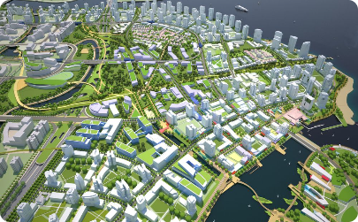

Benefits and Applications
Importance of Predicting AQI
Use Cases for AQI Prediction
Potential Benefits of Accurate Prediction Models
Explore the significance of predicting the AQI, including proactive urban planning and health advisories for vulnerable communities.
Discover the diverse applications of AQI predictions in different sectors, such as agriculture, transportation, and public health.
Learn about the positive impacts of precise AQI predictions and their potential to promote healthier lifestyles and reduce adverse effects on the environment.

Slide 5

Challenges and Limitations
1
Data Limitations and Availability
2
Uncertainties in Predicting Air Quality
Explore the challenges posed by limited data availability and the need for better data collection and maintenance for accurate predictions.
Discuss the inherent uncertainties in predicting air quality due to complex atmospheric dynamics, meteorological conditions, and chemical reactions.
3
Complexities in AQI Prediction
Examine the complexities associated with predicting the AQI for different geographical locations, considering regional variations in pollution sources and atmospheric conditions.

Slide 6
code:
Import necessary libraries
import numpy as np import pandas as pd import matplotlib.pyplot as plt from sklearn.model_selection import train_test_split from sklearn.linear_model import LinearRegression from sklearn import metrics
Generate synthetic data
np.random.seed(42) n_samples = 1000
temperature = np.random.uniform(10, 35, n_samples) humidity = np.random.uniform(20, 80, n_samples) wind_speed = np.random.uniform(1, 10, n_samples)
Assume a linear relationship with some noise
aqi = 5 * temperature + 3 * humidity + 2 * wind_speed + np.random.normal(0, 5, n_samples)
Create a DataFrame
data = pd.DataFrame({'Temperature': temperature, 'Humidity': humidity, 'Wind_Speed': wind_speed, 'AQI': aqi})
Split the data into training and testing sets
X = data[['Temperature', 'Humidity', 'Wind_Speed']] y = data['AQI']
X_train, X_test, y_train, y_test = train_test_split(X, y, test_size=0.2, random_state=42)
Create and train the model
model = LinearRegression() model.fit(X_train, y_train)
Make predictions
y_pred = model.predict(X_test)
Evaluate the model
print('Mean Absolute Error:', metrics.mean_absolute_error(y_test, y_pred)) print('Mean Squared Error:', metrics.mean_squared_error(y_test, y_pred)) print('Root Mean Squared Error:', np.sqrt(metrics.mean_squared_error(y_test, y_pred)))
Visualize the results
plt.scatter(y_test, y_pred) plt.xlabel('Actual AQI') plt.ylabel('Predicted AQI') plt.title('Actual vs. Predicted AQI') plt.show()

Slide 7
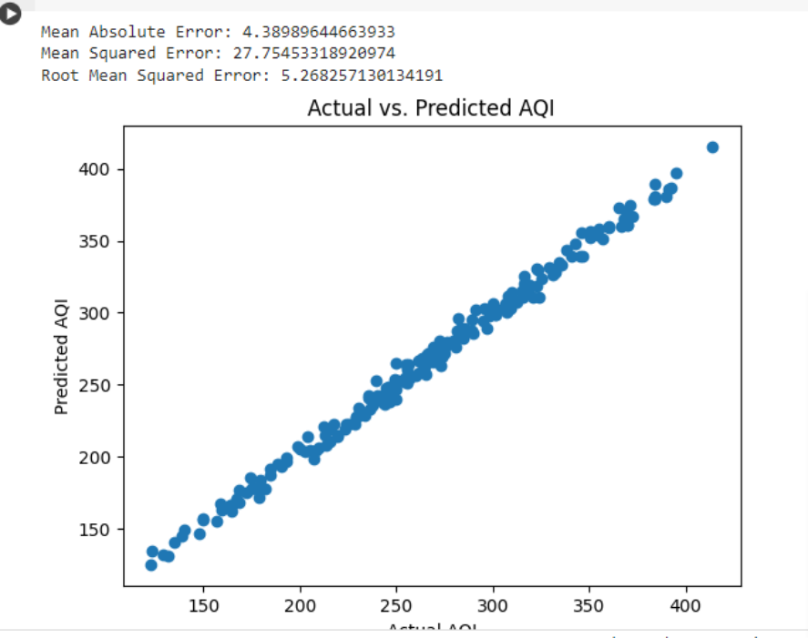
output:

Slide 8

Conclusion and Further Steps
Summary of Key Points
Importance of Ongoing Monitoring and Research
Recap the essential takeaways from the presentation, emphasizing the importance of monitoring air quality and predicting the AQI for the well-being of individuals and the environment.
Highlight the significance of continuous monitoring efforts and the need for further research to enhance our understanding and predictions of air quality.
Encouraging Individuals and Governments to Take Action
Inspire individuals and policymakers to take proactive steps in improving air quality by implementing sustainable practices and supporting policies that prioritize environmental health.

